Slide 1
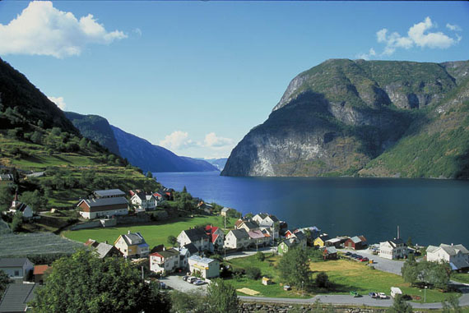
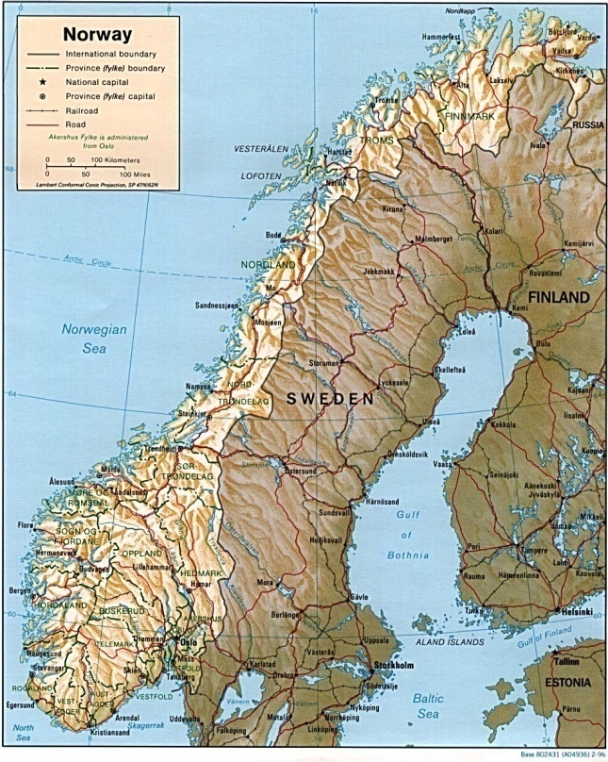
Research in Norway
Presented by Jan Nabers (0824712)
Symposium Studiereis
Radboud University Nijmegen

Slide 2
Content
Norway’s competetive Edge
Research in Norway
Research Council of Norway
Funding in Norway
R&D statistics
Future perpectives

Slide 3
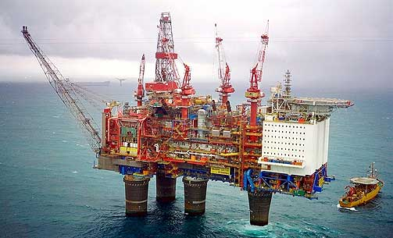
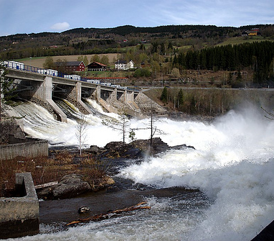
Norway’s competetive Edge
40 years of Oil and gas business
Nationally:
Oil and gas sector : → 21% of GDP
→ 47% of exports
Globally:
2nd largest gas exporter
7th largest oil exporter
Biggest exporter outside the Middle East
100 years of hydro power experience
6th largest producer of hydro power
50% of West-Europe energy storage capacity
Potential for balancing power supply
Expertise from material industry
Aluminium, Silicon
Strong experience in maritime activities

Slide 4
OECD’s challange for Norway
“The key strategic task ahead is to maintain high sustainable growth even after oil and gas production has peaked. Any foresceeable restructuring of the Norwegian economy compatible with this goal will entail a shift towards other knowledge-based activities” (Report 2008 on Norwegian Innovation Policy)
Key factors to archief this:
→Education
→Research
→International Collaboration

Slide 5
Marine Research
Total national Budget for R&D in 2011 550 billion NOK
Technology
Marine Research
Biotechnology and Life Science
[Research Council of Norway]

Slide 6
Focus of Research and Development in Norway
Fundamental Science
Medicin and Health
Biotechnology
New Materials, Nanotechnology
Information and communication technologies
Marin science
Energy and environment

Slide 7
Strategic governmental Agency
Advices the government in questions of research
Financial support for public and private R&D projects
Creates arenas for cooperations
[Research Council of Norway]

Slide 8
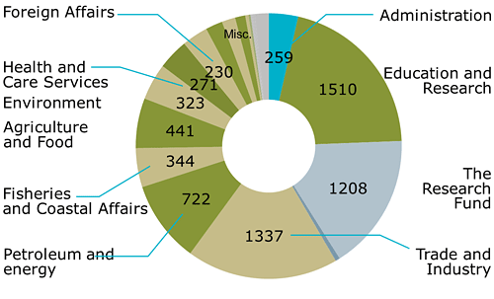
Total budget of Research council in 2011 NOK 6, 9 billion ≈ EUR 900 million
Funding received from the ministries
[Source: Research Council of Norway]

Slide 9
The Norwegian System of Education, Research and Innovation

Slide 10
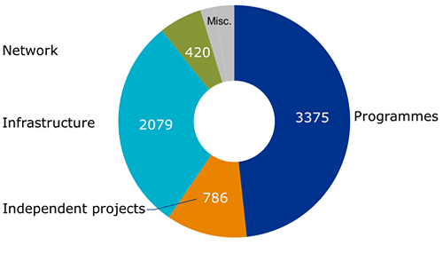
Funding dividded into research efforts
[Source: Research Council of Norway]

Slide 11
Fundings in Norway
Norwegian Centers of Excellence (SFF)
Norwegian Centers for Research based Innovation (SFI)
Research Council of Norway large Scale R&D programs
Independent research organisation in Scandinavia SINTEF
Independent Project Funding FRIPRO
Industrial Development Corporation Norway SIVA (selskapet industrivekst)
Non profit Organisations

Slide 12
Large Scale R&D Programms
Biotechnology for Innovation BIOTEK2012 (FUGE)
AQUACULTURE - An Industry in Growth – HAVBRUK
Nanotechnology and Advanced Materials - NANO2021
Climate Change and its Impacts in Norway – NORKLIMA
Optimal Management of Petroleum Resources - PETROMAKS
Clean Energy for the Future - RENERGI
Core Competence and Growth in ICT - VERDIKT

Slide 13
Norwegian Centers of Excellence SFF
Theoretical chemistry (CTCC)
Theoretical Linguistics (CASTL)
Communication systems (Q2S)
Ships and ocean structures (CeSOS)
Biology of memory (CBM)
Mind in Nature (CSMN)
Cancer Biomedicine (CCB)
Immune Regulation (CIR)
Biomedical Computing (CBC)
Molecular Biology and Neuroscience (CMBN)
Mathematics for Applications (CMA)
Civil Wars (CSCW)
Geological Processes (PGP)
Geohazards (ICG)
Ecological and Evolutionary Synthese (CEES)
Equality, Social Organization, and Performance (ESOP)
Geobiology (CGB)
Climate research (BCCR)
Medieval studies (CMS)
Integrated Petroleum Research (CIPR)
Aquaculture protein Centre (APC)

Slide 14
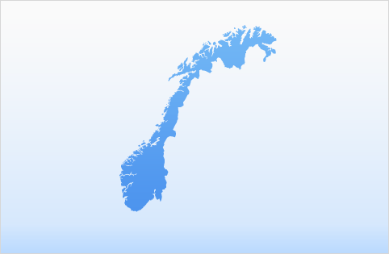
Centers for Research based Innovation SFI
Telemedicine (TTL)
Marine bioactivity & drug discovery (MABCENT)
Industrial measurement technology (CMR)
Sea Lice
Innovation in Sustainable fish capture and Processing (CRISP)
Service Innovation (CSI)
Integrated Operations in the Petrol industry (IO-CENTRE)
Aquaculture Technology (CREATE – SFI)
Sustainable Arctic Marine and Coastal Technology (SAMCoT)
Concrete innovations (COIN)
Medical Imaging (MI LAB)
Future manufacturing (SINTEF)
Structural Impact (NTNU)
Cardiology Innovations (CSI)
Natural Gas Processes and Products (INGAP)
Multiphase flow of complex fluids (FACE)
Statistics for innovation (SFI2)
Stem cell based tumor therapy (CAST)
Information Access Disruptions (IAD)
Total Budget for all centers:
About 1billion NOK

Slide 15
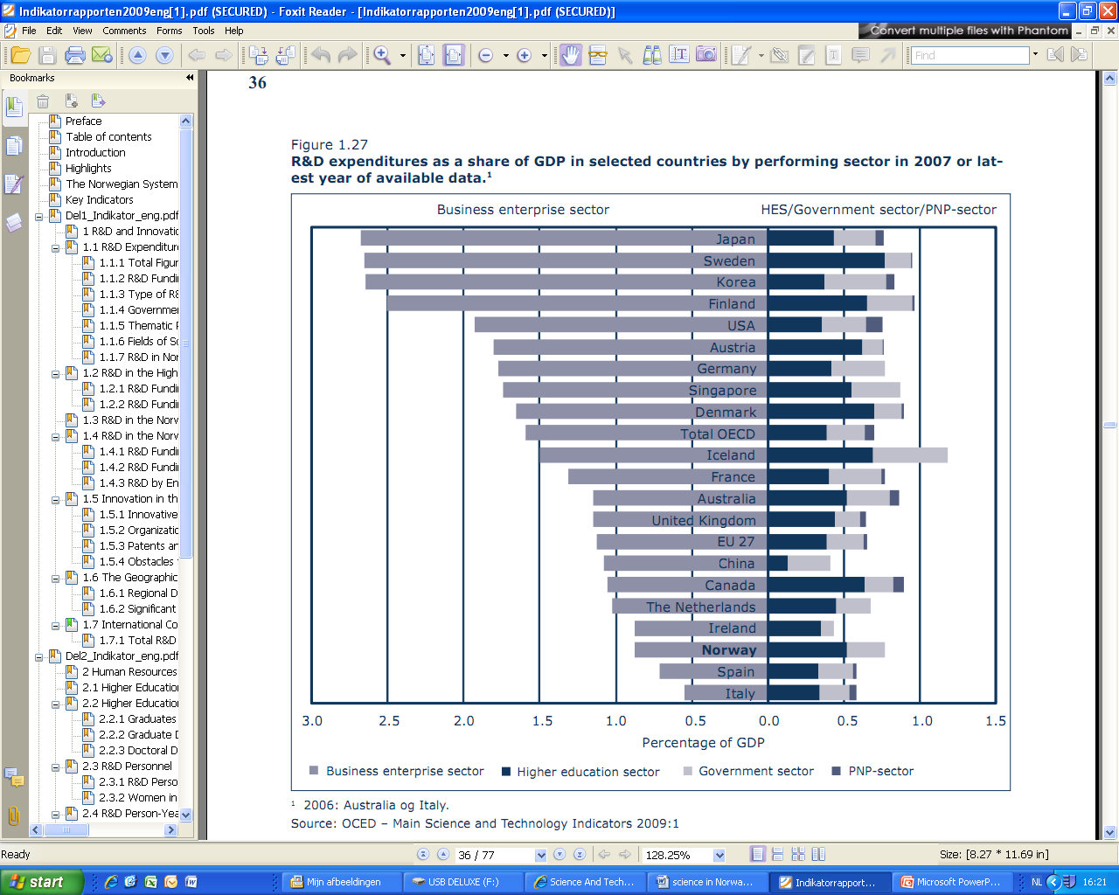

Slide 17
Future perspectives
Internationalisation
Fundamental Research
Research based Innovations
Focus of Research and Development in Norway
Fundamental Science
Medicin and Health
Biotechnology
New Materials, Nanotechnology
Information and communication technologies
Marin science
Energy and environment
Notes:
Following a new white paper of government

Slide 18
Questions ?!?

