Slide 1
Sweden
28-02-2012, Nijmegen
Johan Svedberg & Ulrika Ehrenstråhle

Slide 2
Agenda
- Typical Swedish
- Nature & Climate
- Food, Culture & Language
- Travel Within Sweden
- Education
- Swedish Student Life
- What Differs From Netherlands?
- ‘’Do’s and Dont’s’’

Slide 3
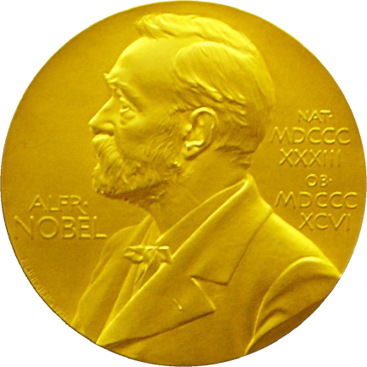
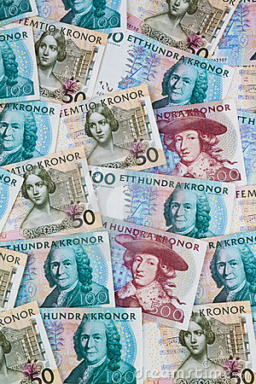
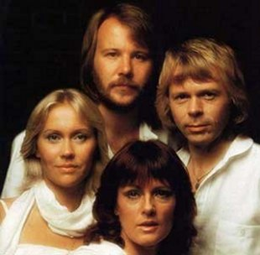
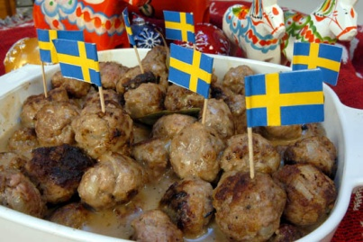
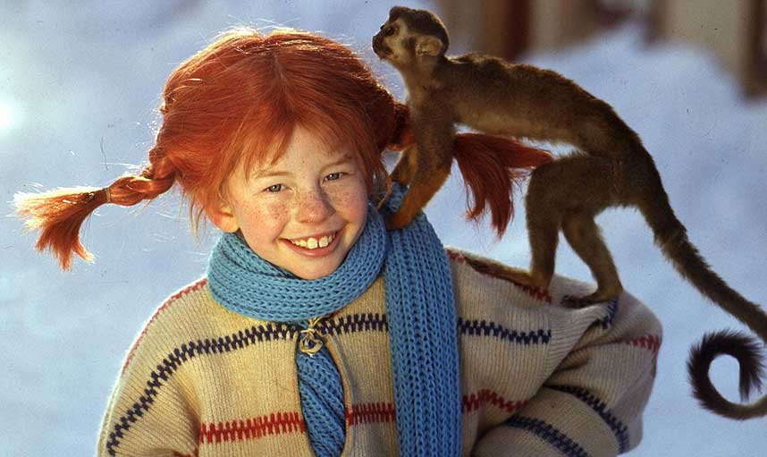
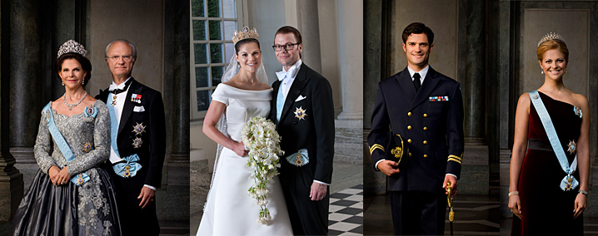
Typical Swedish?

Slide 4
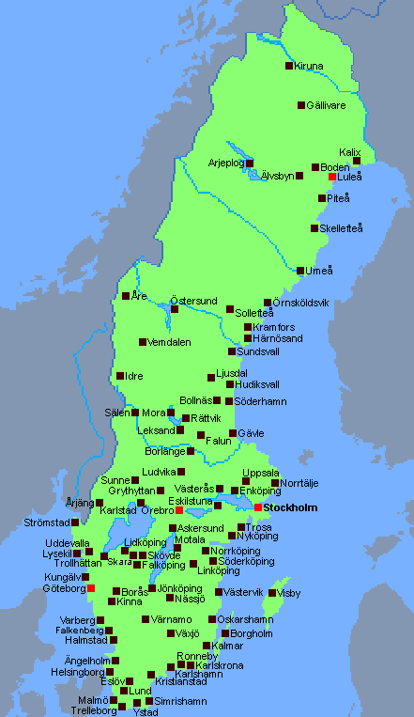
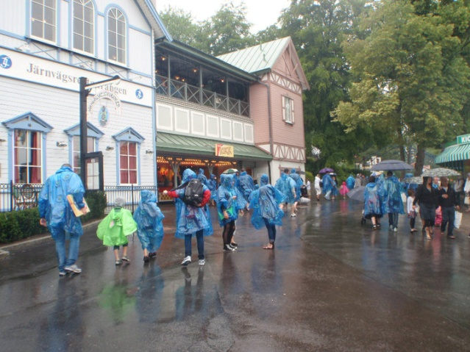
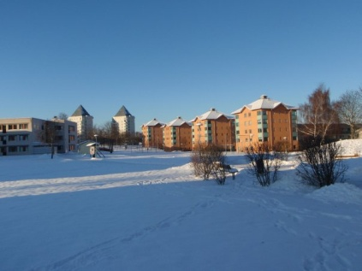
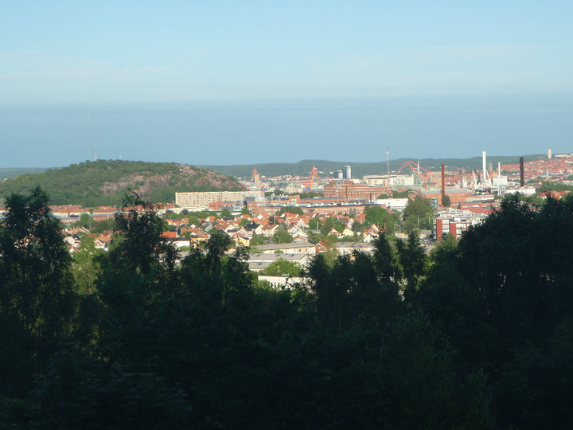
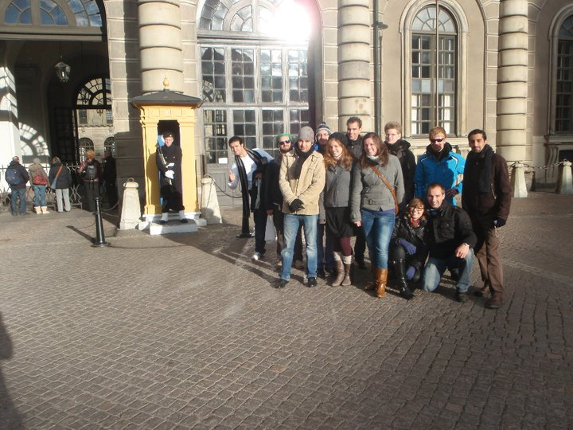
Four Different Seasons

Slide 5
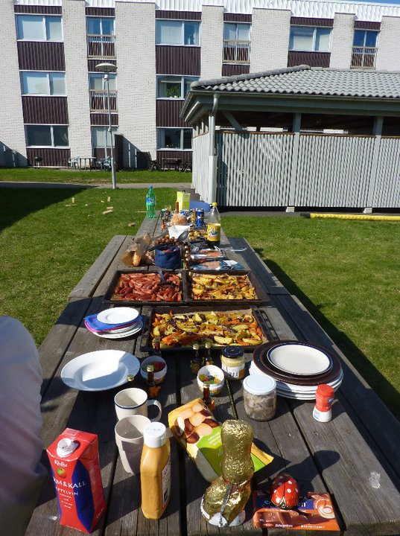
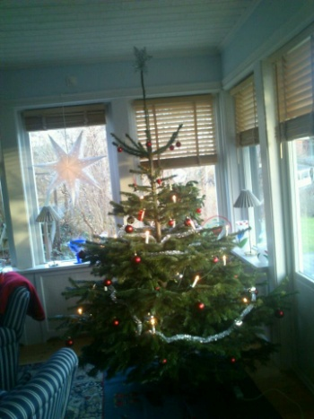
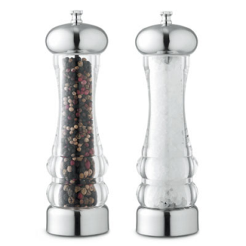
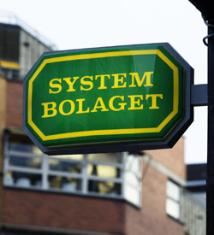
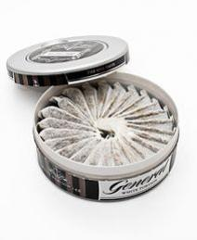
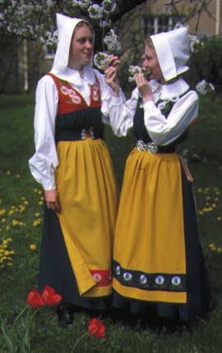
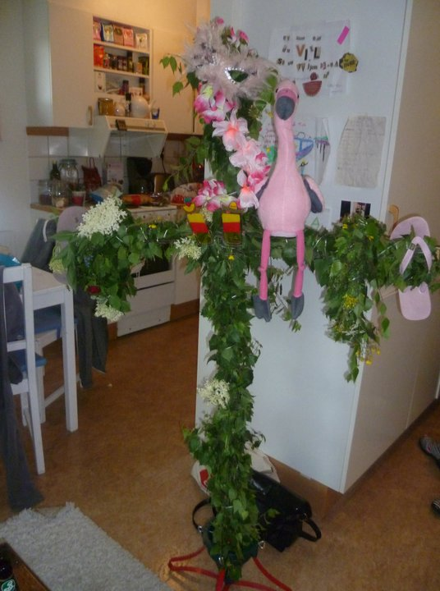
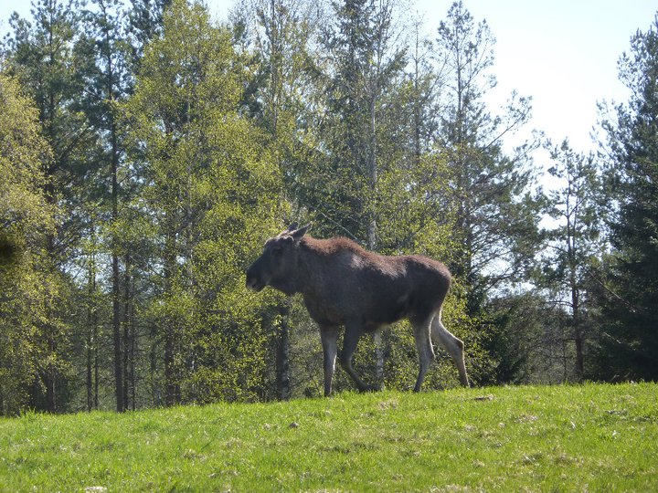
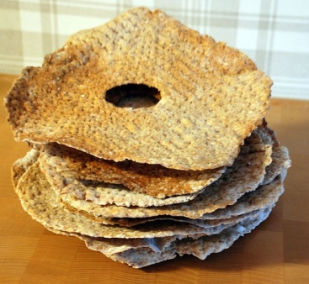
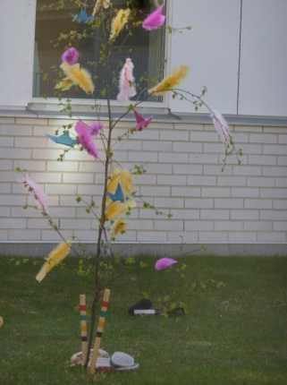
Food & Culture

Slide 6
Travel Within Sweden
Useful websites:
www.sj.se (train) www.svenskabuss.se (bus)
www.sas.se (airplane) www.swebus.se (bus)

Slide 7
Germanic
Å Ä Ö
Dialects
Standard Swedish
Language
- Finnish
- Romani Chib
- Yiddish
- Samish
- Meankieli (Tornedal
Finnish)
9,4 millions in Sweden
1 million outside Sweden

Slide 8
Education
0an (age 6)
1-9th grade compulsory
(age 7-16)
High School (age 17-19)
English?

Slide 9
Money
University / ‘’Högskola’’
Income
Costs
What?
Where?
Housing
When?
Extrawork
Swedish Student Life
Courses
Points
Grades
Exams
Bachelor
Master
Student Union
Holidays
Student Discounts
Associations
Pubs & Bars
‘’Nations’’

Slide 10
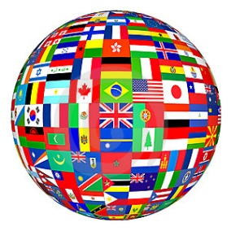
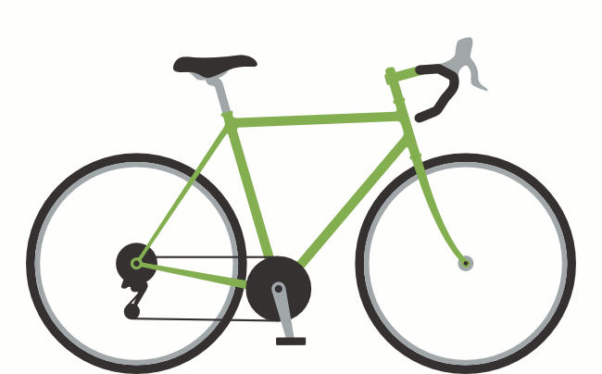
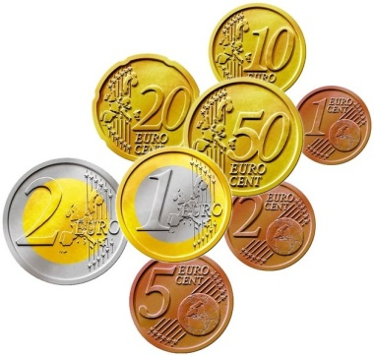
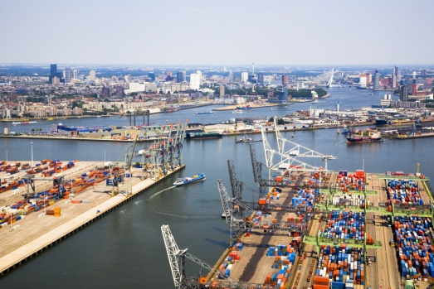
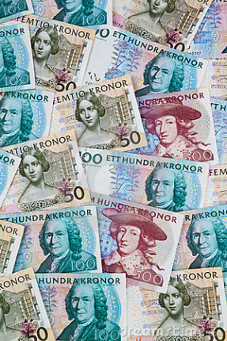
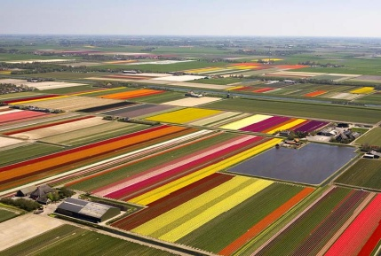
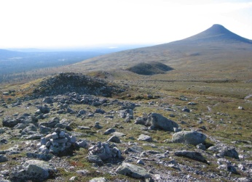
1614
Migration 2000-2011
Monarchy
Queen Beatrix –
King Carl XVI Gustav
Crown Princess Victoria –
Crown Prince
Willem Alexander
& Princess Amalia
700-1200
500-600
Space
Work
Sweden & the Netherlands
Tourism!

Slide 11
In the escalator:
‘’Rechts staan - Links gaan’’
Tack!
Littering!
“ Do’s and Dont’s ”
Private Space
Alcohol,
smoking
&
Drug law
112
ICE

Slide 12
www.visitsweden.com/zweden

