Slide 1
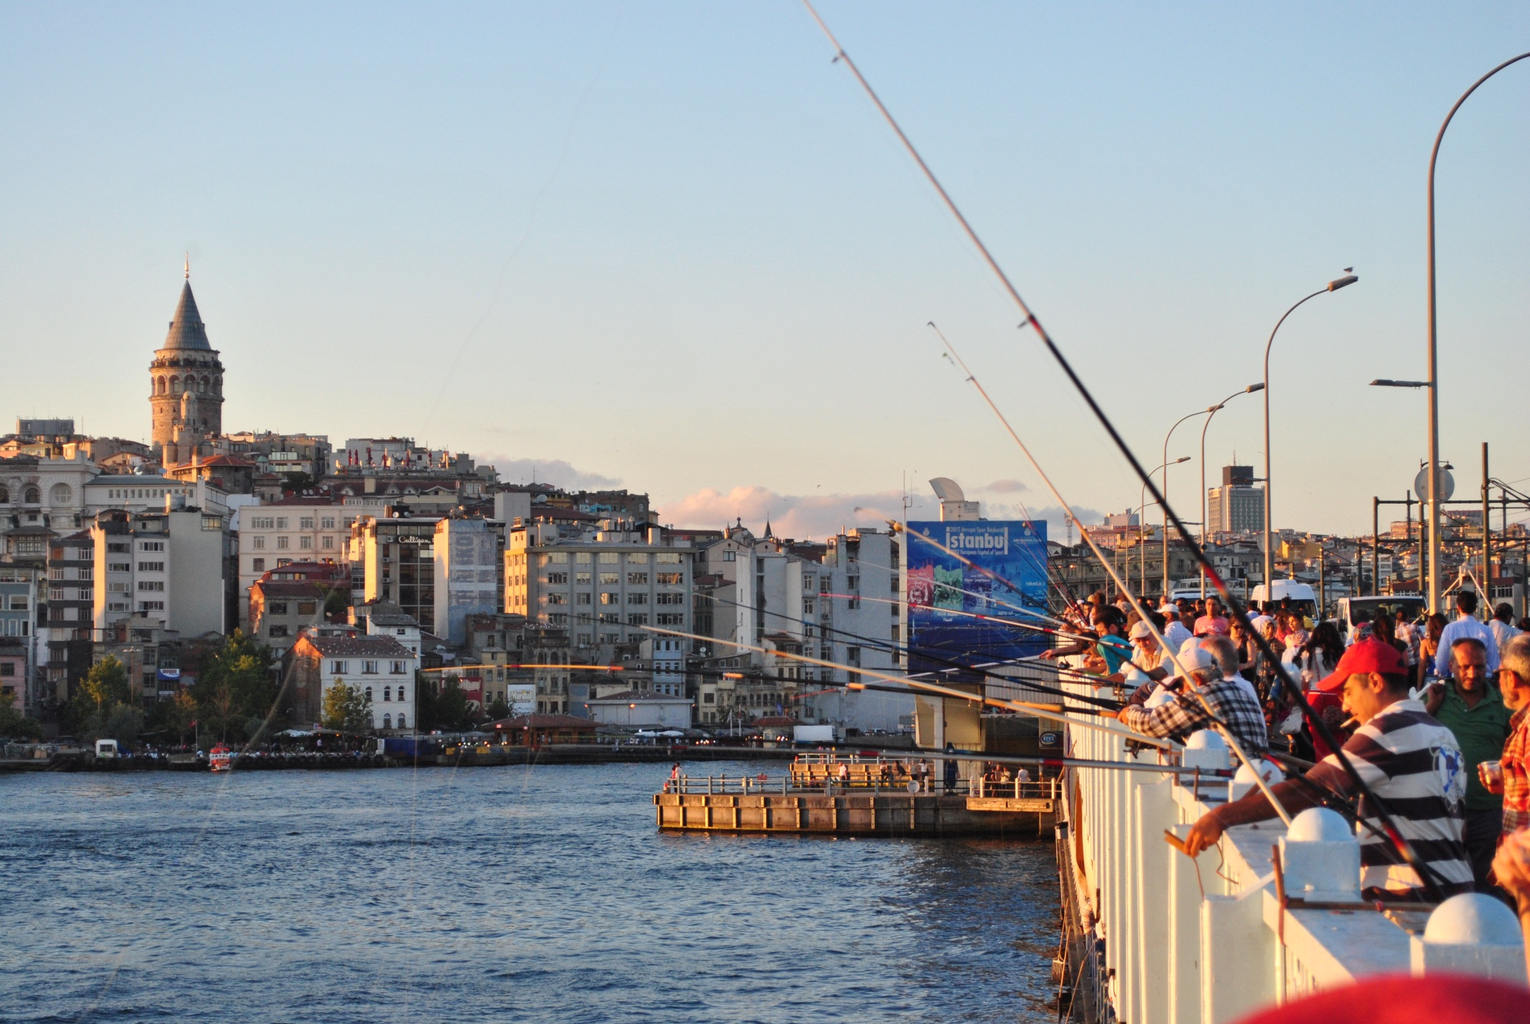
Türkiye
ybarık™
Yusuf Bilgehan ARIK

Slide 2
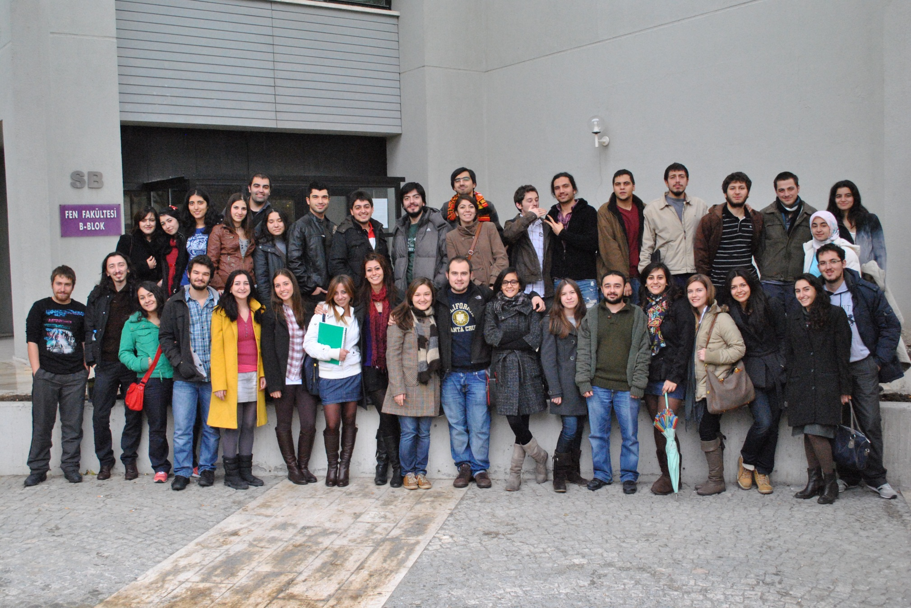
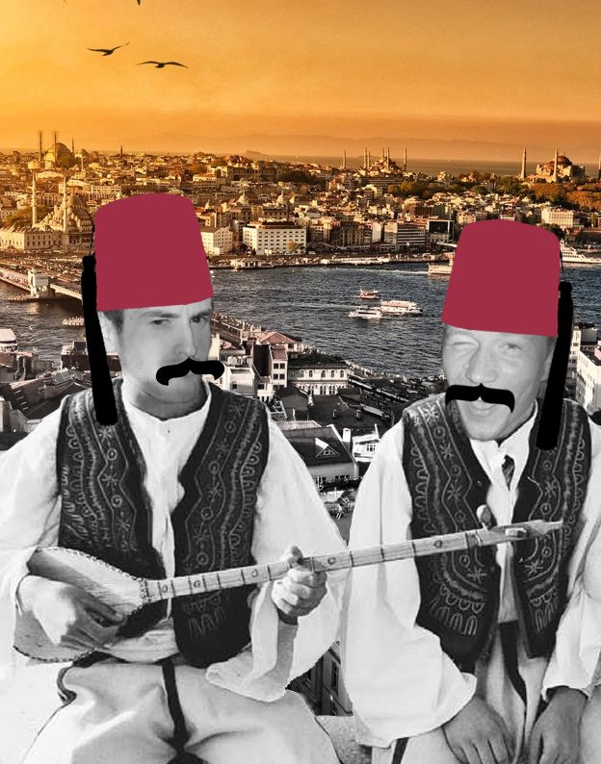

Slide 3
Education
LGS (High school entrance exam) (1.5 million people)
ÖSS (University entrance exam) (2.5 million people)
180 questions in 195min. (Turkish, Social and theoretical science, math and geometry)
Scholarships for people who are in top 5000
For people who choose science and in top 5000, Turkish Science Foundation gives 400Є/month
For people who are in top 1000, Turkish government gives 250Є
Many more scholarships in private universities (100- 500Є)

Slide 4
In universities
The grading system:
Final letter grade from F to A+
Exam grade from 0-100 Compare to Netherlands getting 100 is easier.
Life expenses:
Depends on the university (Main cities around 500Є)
Transportation in Ankara is not very developed.
2 subway lines, many bus lines, mini busses, university shuttles
You are lucky in Bilkent Uni. and METU

Slide 5
Almost every shop is open everyday until 22.00
One of the best things in Turkey
EVEN ON SUNDAYS

Slide 6
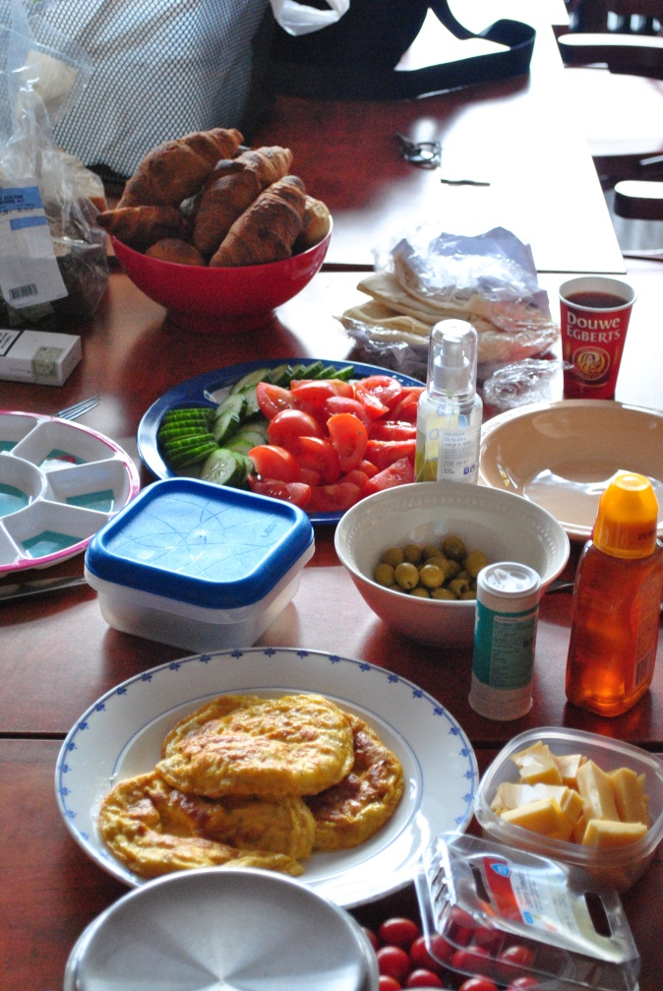
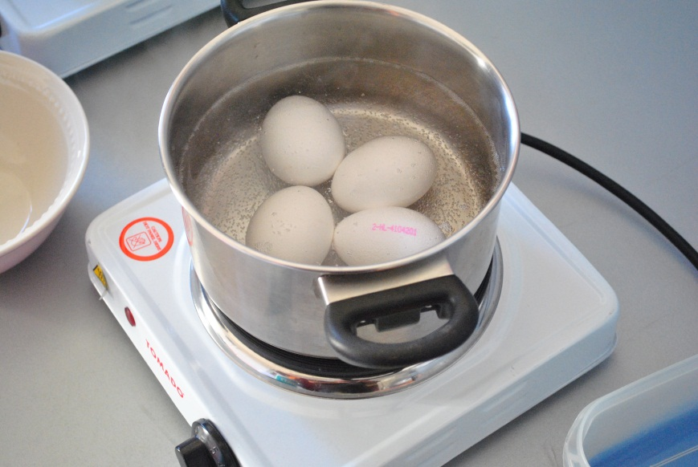
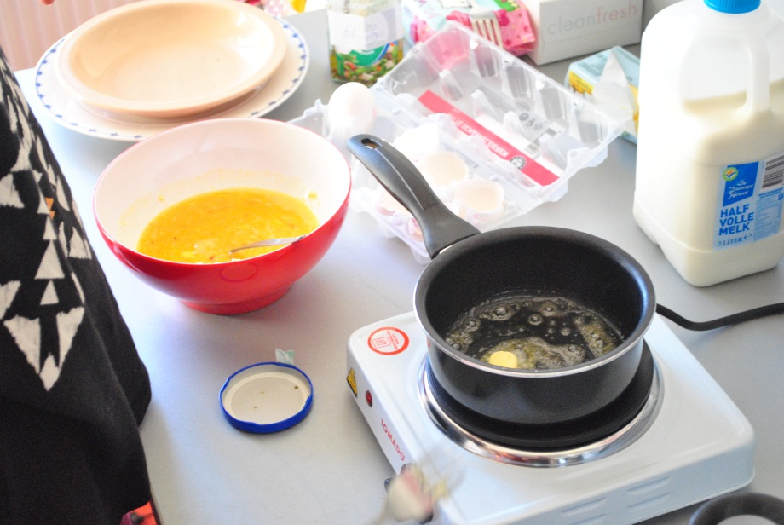
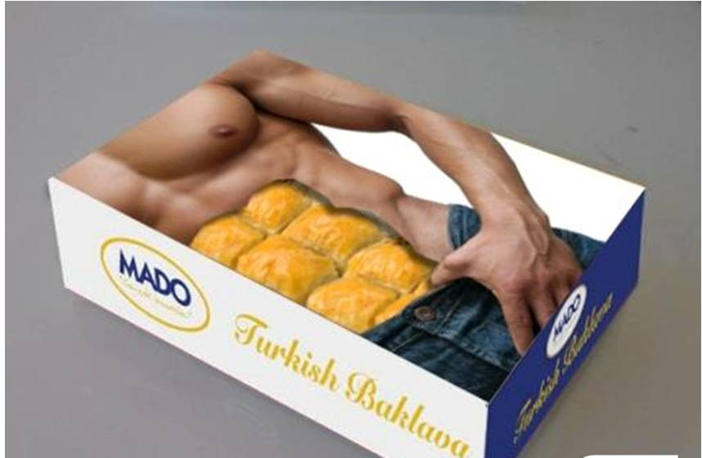
Culture
Very very rich cuisine

Slide 7
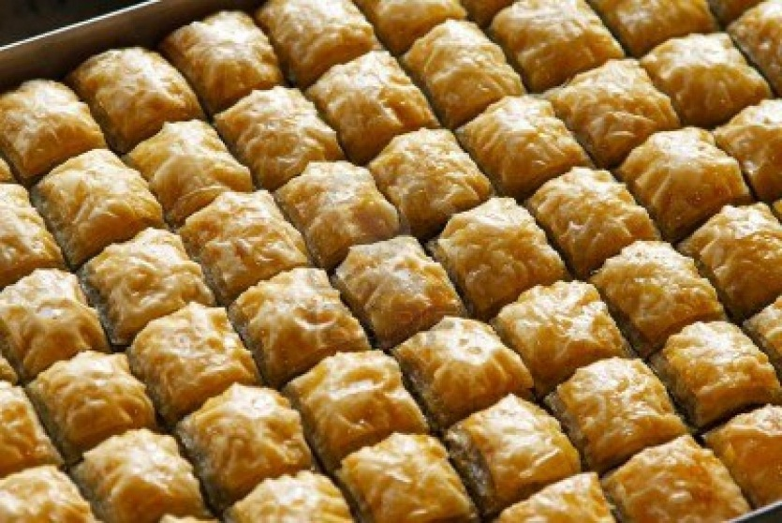
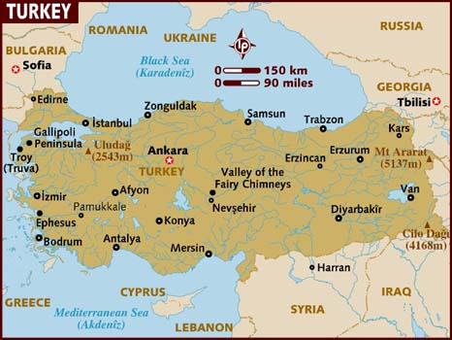
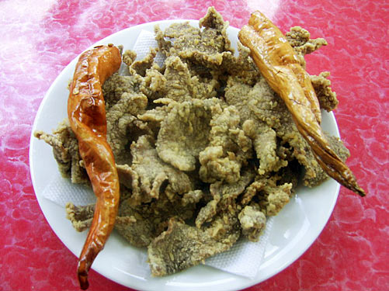
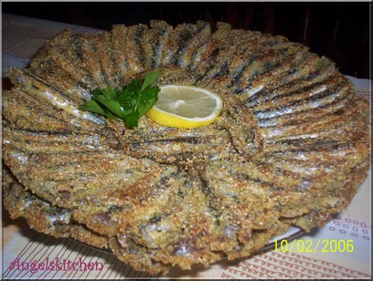
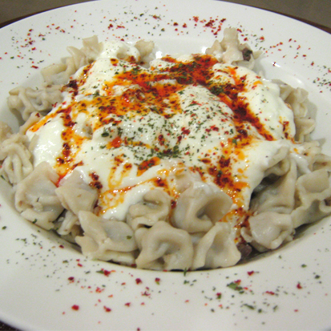
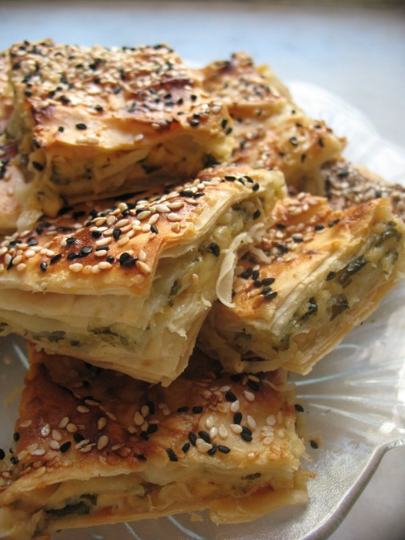
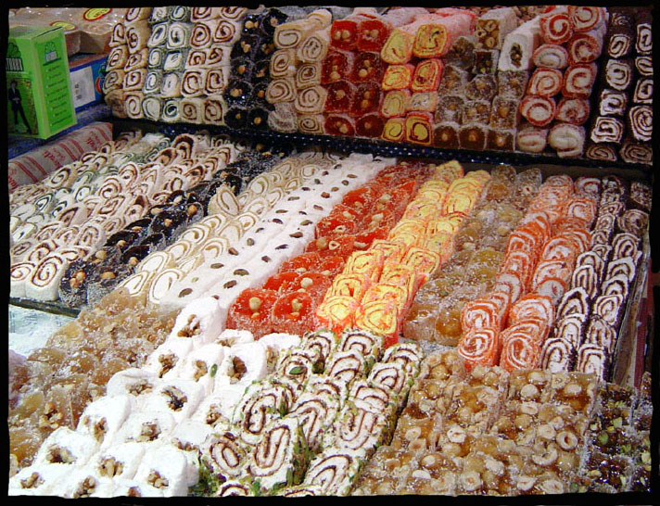
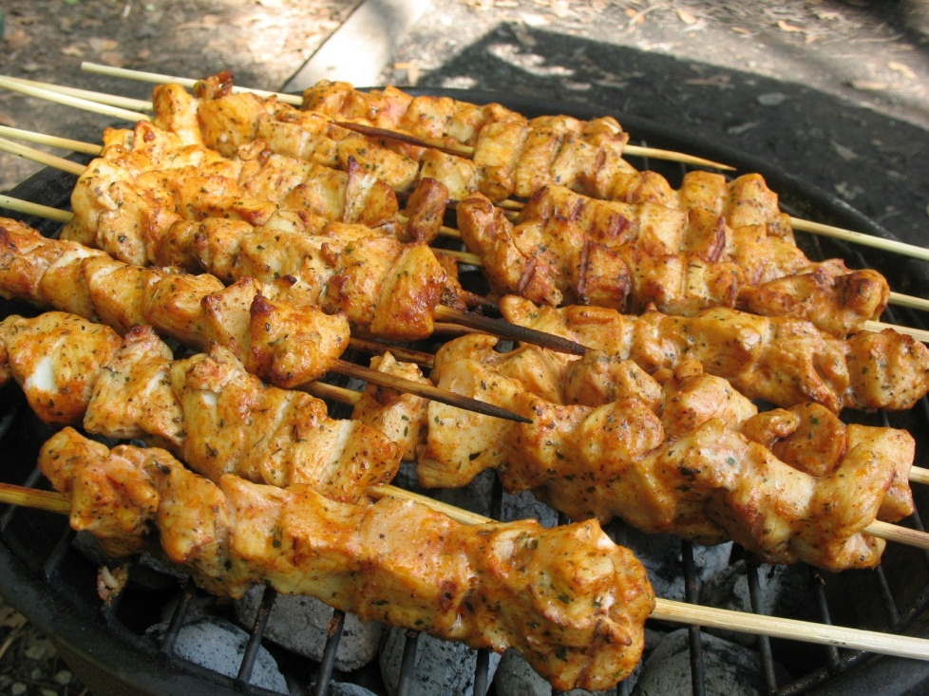
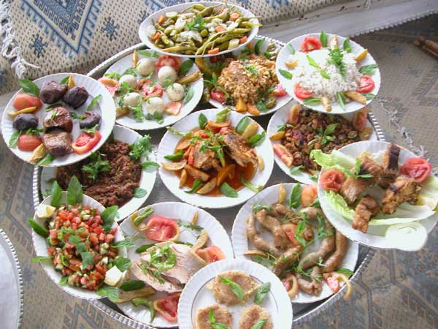
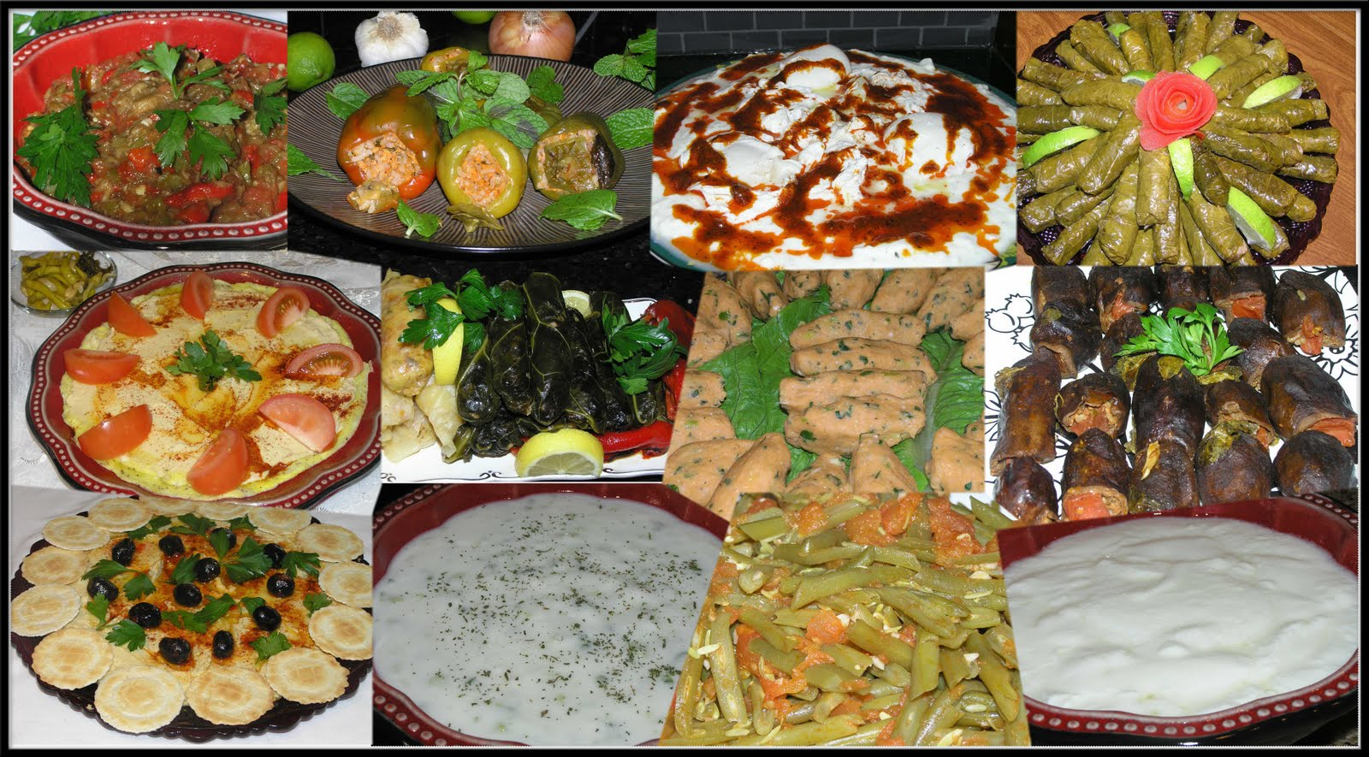
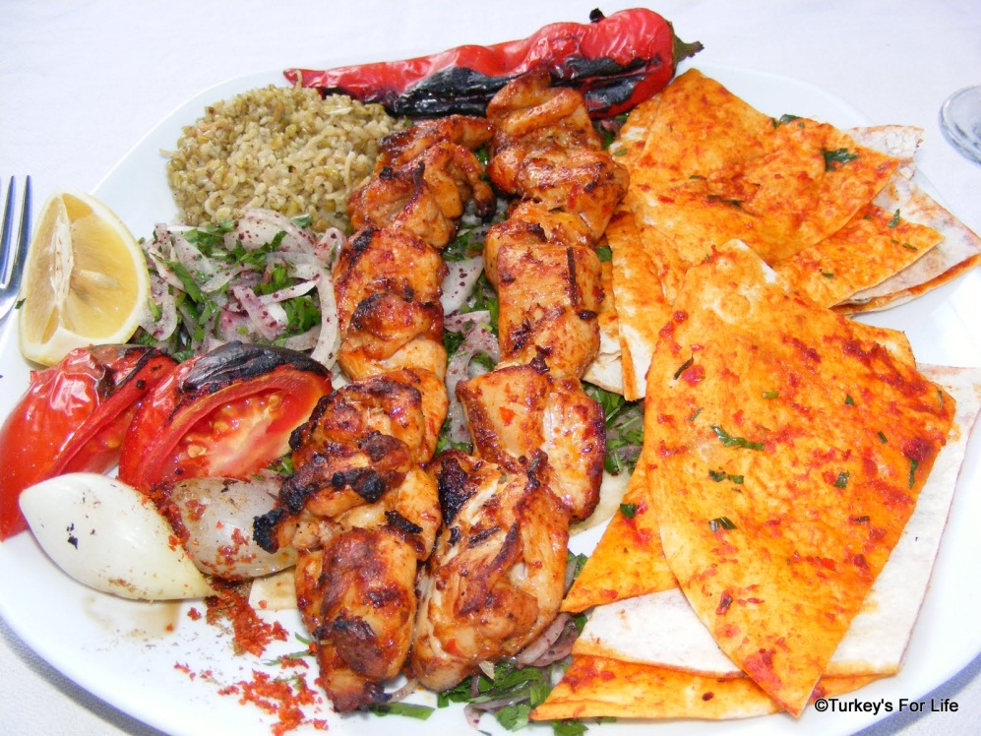
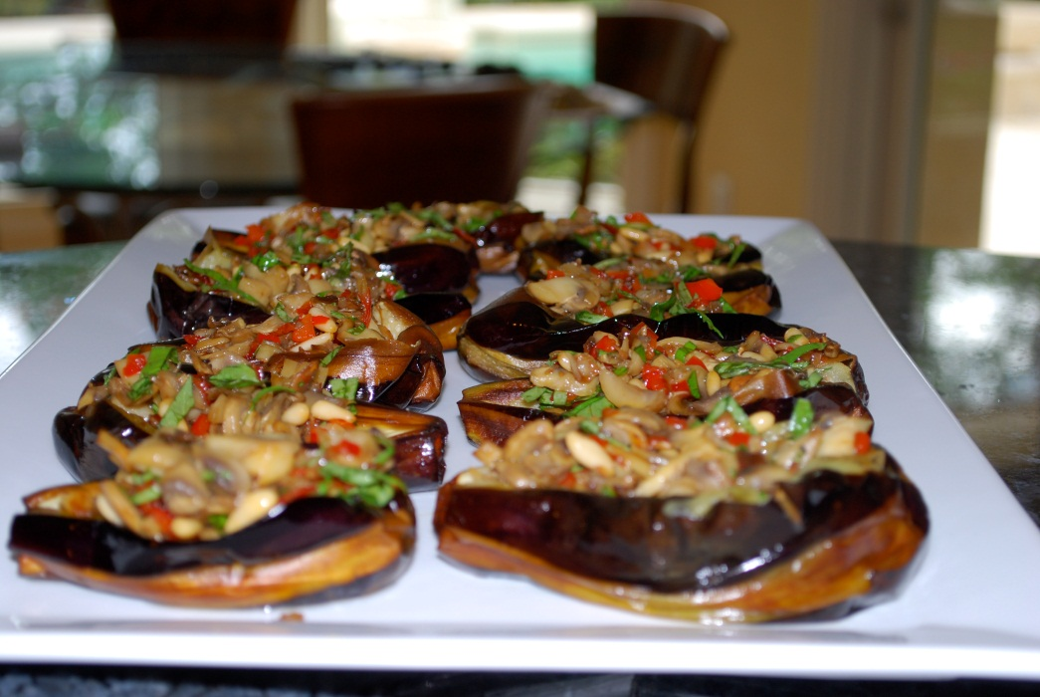

Slide 8
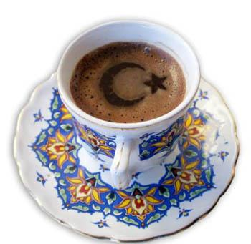
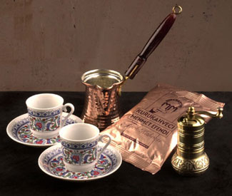
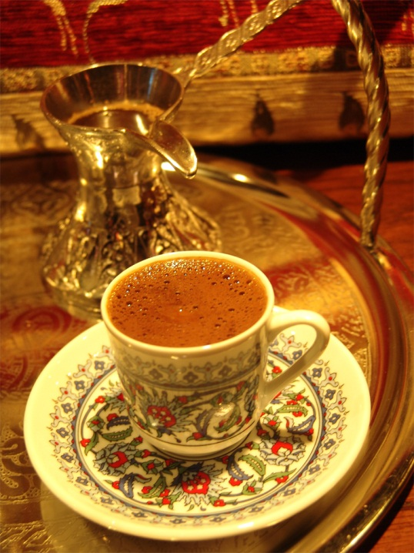
Turkish coffee
Notes:
As well as an everyday beverage, Turkish coffee is also a part of the traditional Turkish wedding custom. As a prologue to marriage, the bridegroom's parents (in the lack of his father, his mother and an elderly member of his family) must visit the young girl's family to ask the hand of the bride-to-be and the blessings of her parents upon the upcoming marriage. During this meeting, the bride must prepare and serve Turkish coffee to the guests. For the groom's coffee, the bride-to-be sometimes uses salt instead of sugar to gauge his character.
The grounds left after drinking Turkish coffee can be used for fortune-telling. The cup is commonly turned over into the saucer to cool, and then the patterns of the coffee grounds can be used for a method of fortune telling

Slide 9
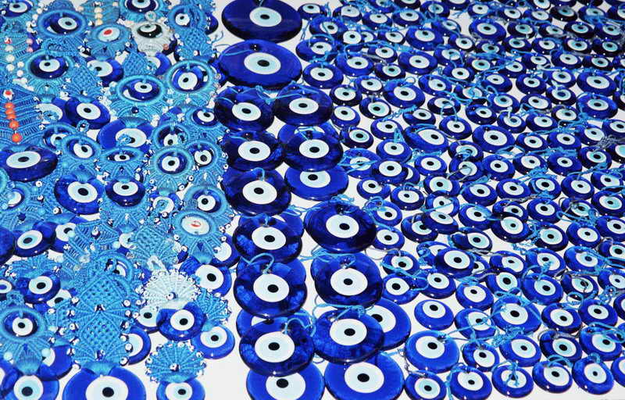
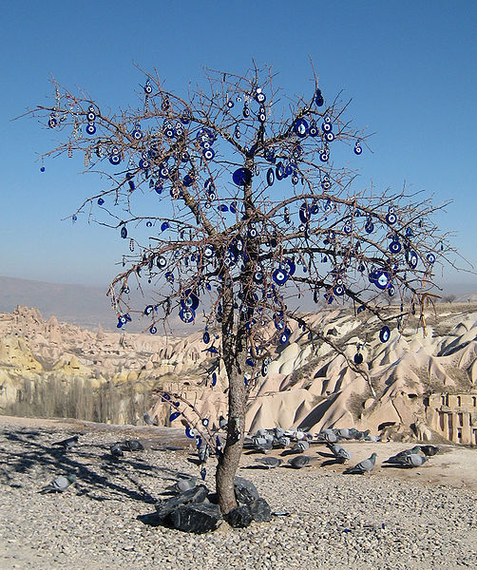
The Evil Eye (Nazar)
Notes:
The evil eye is a look that is believed by many cultures to be able to cause injury or bad luck for the person at whom it is directed for reasons of envy or dislike.

Slide 10
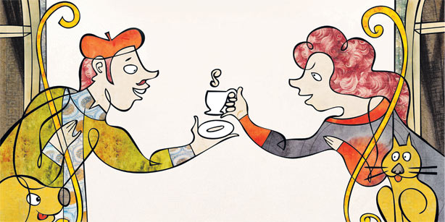
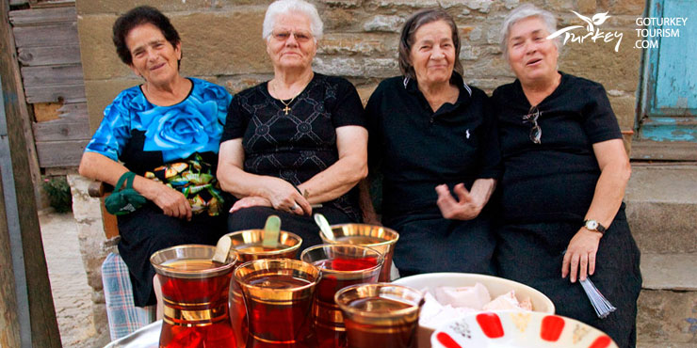
Turkish hospitality is a way of life
Notes:
Hospitality plays a great part in Turkish culture and traces its roots to the nomadic origins of Turkish people. In those days it was very important to be kind to strangers and offer them food and shelter because often their survival would depend on it. This aspect of Turkish culture is visible today across Turkey where it is not unusual for visitors to be offered food and beverages from shop owners in the bazaar, or even to be offered shelter for three nights in the homes of rural Turkish villagers.

Slide 11
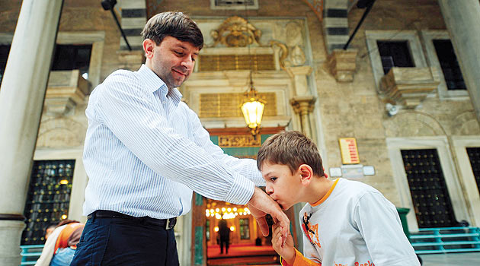
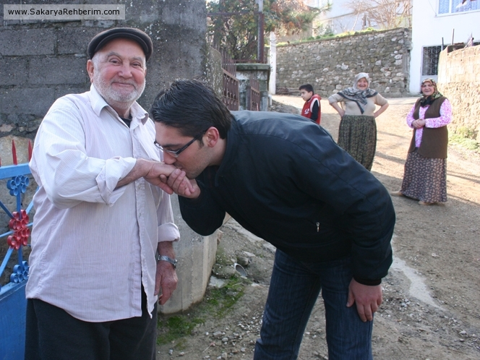
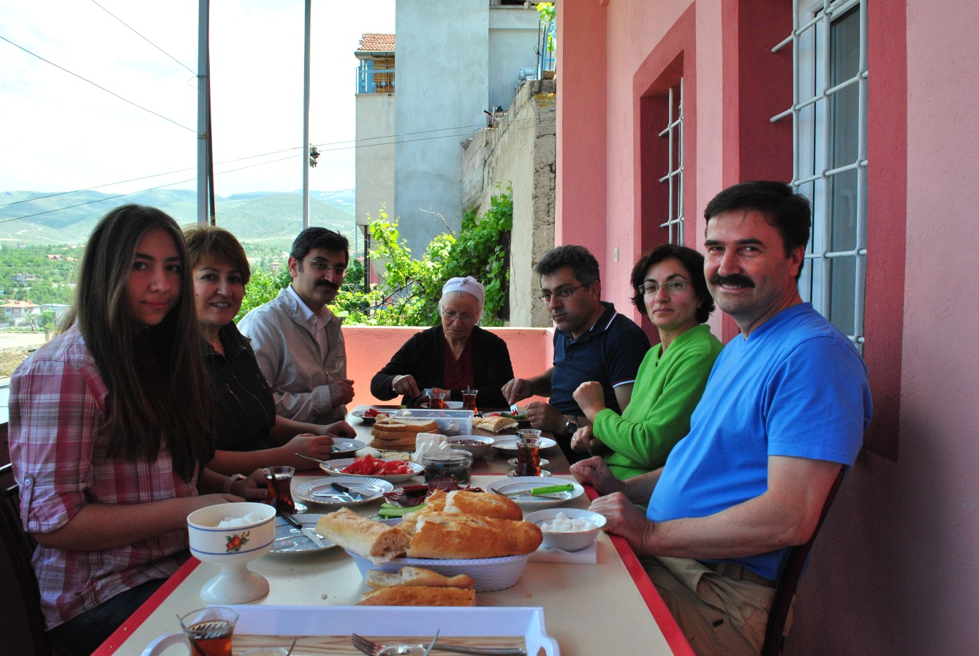
Respect for elders
Notes:
There is no question that Turkish society is one in which elders are revered -- this difference was glaringly obvious to my elderly guests, although all of my guests noticed this difference. For example, one of my elder friends walked with a cane. She was just amazed at how people, young and old, flew up out of their seats when she boarded a tram or a bus to ensure that she had a seat. Reflecting on her month's stay, she commented that she had never been treated so well in her entire life -- and she was serious about that

Slide 12
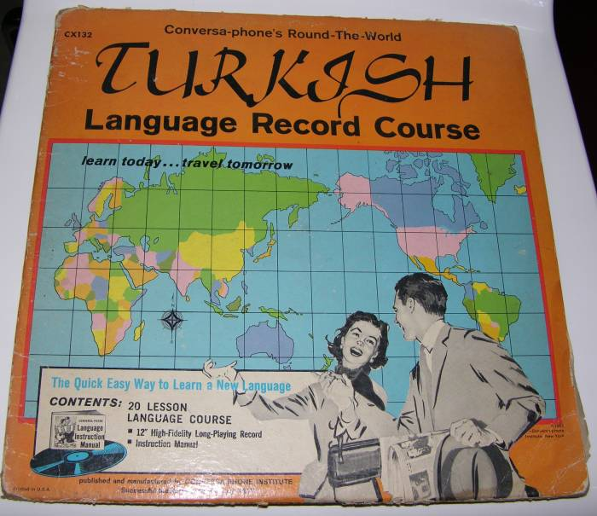
TURK101: Introduction to Turkish
Why are we having hard time in speaking English?
I haven’t opened it: Açmadım.
Aç-ma-dı-m
Different Turkish letters is difficult to pronounce.
Ö → Ö
Ü → Ü
Ş → -sch (Französisch (german for “french”))
Ğ → Soft G
Ç → -tsch (Deutschland (german for “germany”))
To open
Tense
Negative
Subject
No comparison of Present, future, past perfect tenses.

Slide 13
TURK101: Introduction to Turkish
Hello: Merhaba
Goodbye: Güle güle
Please: Lütfen
Thank you: Teşekkürler
You’re welcome: Rica ederim
Yes: Evet
No: Hayır
Of course: Tabi ki
Excuse me: Afedersiniz
How are you: Nasılsınız?
Open: Açık
Closed: Kapalı
What is your name?: Senin adın ne?
My name is …: Benim adım ....
How much?: Ne kadar? May I have the bill?: Hesabı alabilir miyim?
1: Bir
2: İki
3: Üç
4: Dört
5: Beş
6: Altı
7: Yedi
8: Sekiz
9: Dokuz
10: On
11: On bir
50: Elli
100: yüz
1000: bin

Slide 14
Facts About Turkey
Turkey is home to two of the Three Wonders of the World, the temple of Artemis at Ephesus, & the Mausoleum at Halicarnassus (present day Bodrum)
St Nicholas, popularly known as Santa Claus, was born & lived in Turkey
Noah’s Ark is said to have landed at Mount Ararat in Eastern Turkey
Turkey provides 70% of the world’s hazelnuts
Gave the English language plenty of words including chock-a block, turquoise, yoghurt, kismet, kilim & parchment
Turkey first introduced tulips to Holland & today still supplies tulips worldwide. The tulip is also Turkey’s national flower
Turkey was the first ever land to mind & use coins 2700 years ago by the Lydians
Turkey has the world’s first female Supreme Court Judge, & gave the ladies the right to vote in 1934

Slide 15
?
Fragen?
Questions?
?
?
?
سؤال?
Sorular?
?
Vraagen?
?
Praguntes?

